Slide 1
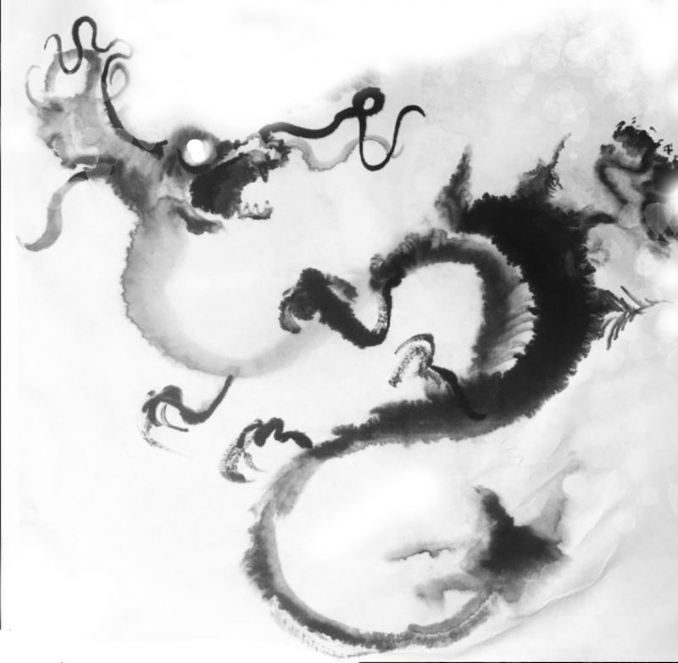
The Black Dragon Girl
An animated show about a new girl boarded at an art high school

Slide 2
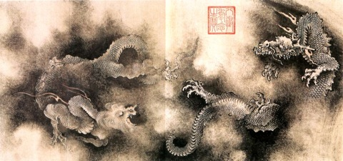

Slide 3
Zhang Sengyou, “Paint the Dragon Eyes” - A Chinese Fable
About 1,500 years ago in China's South Dynasty (420-589), there was a renowned painter whose name was Zhang Sengyou. In addition to serving as the court's royal librarian, Zhang also held the post of a general and a governor.
A legendary painter, Zhang commanded great respect from both the Emperor and commoners. He loved to paint animals, flowers, mountains, and rivers. Outside of his house he painted a vulture on one side and a hawk on another. His paintings were so vividly alive that birds were too scared to build nests around the house.
Once, monks from the Anle Temple in the southern city of Nanjing invited him to paint dragons on the temple wall. People heard this news and came to watch this famous artist paint. In a short time, Zhang painted four lifelike dragons with his magical brush. But people quickly discovered that the dragons did not have eyes. They all wondered why.

Slide 4
Zhang explained, “The dragons' eyes hold their spirits, without which their bodies are merely physical things. If I paint their eyes, they would fly away.” The on-lookers shook their heads in disbelief.
Zhang breathed out a sigh, and took up his brush. He quickly painted eyes on two of the dragons. Suddenly, the sky darkened, thunder roared, and rain came down hard. The two dragons that had painted eyes broke through the wall and flew swiftly heavenward with a thunderbolt.
Watching all of this, the people turned speechless. The sky quickly brightened up again, and on the temple wall were left two dragons without painted eyes.
Generations have passed and some people still believe the eyed dragons under Zhang Sengyou's brush did become alive. Regardless, this story has given birth to the expression “paint the dragons' eyes,” which refers to vivid spirit portrayed skillfully in artistic work.
Source: Based on “A Chronicle of Famous Paintings from Past Dynasties (Lidai Minghua Ji)” compiled by Zhang Yanyuan, a painter who lived in the Tang Dynasty (618-907).

Slide 5
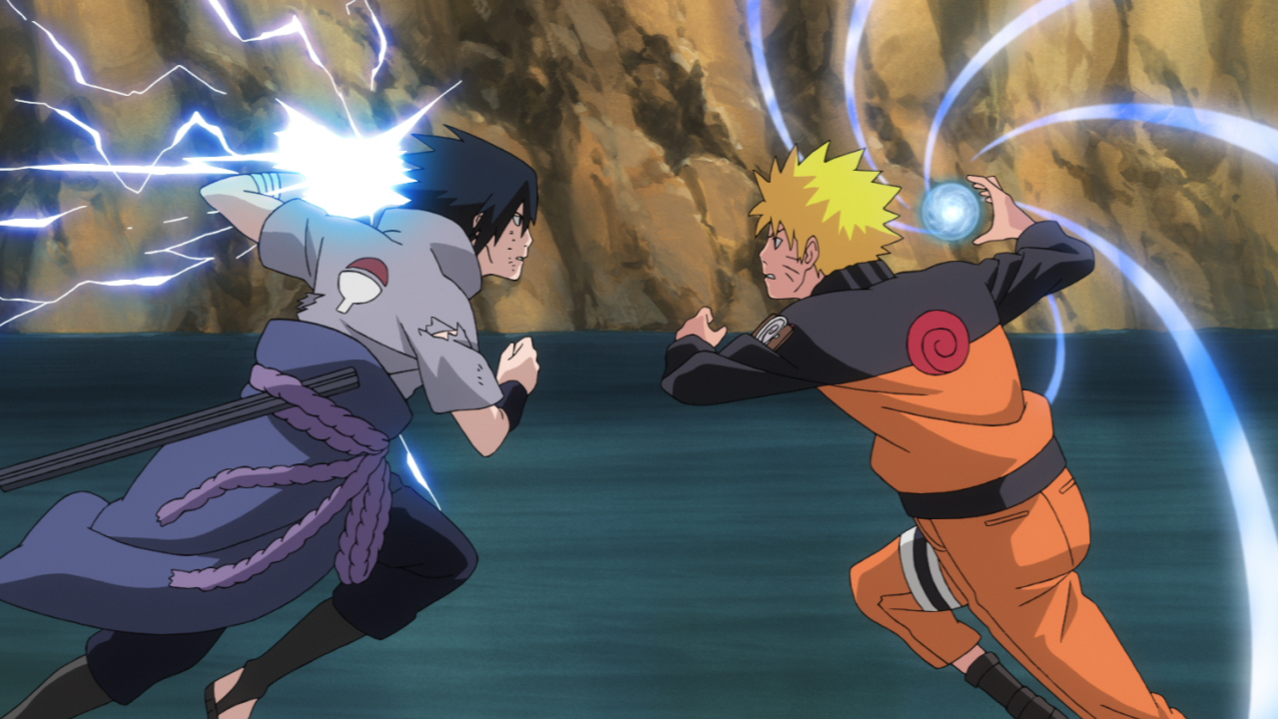
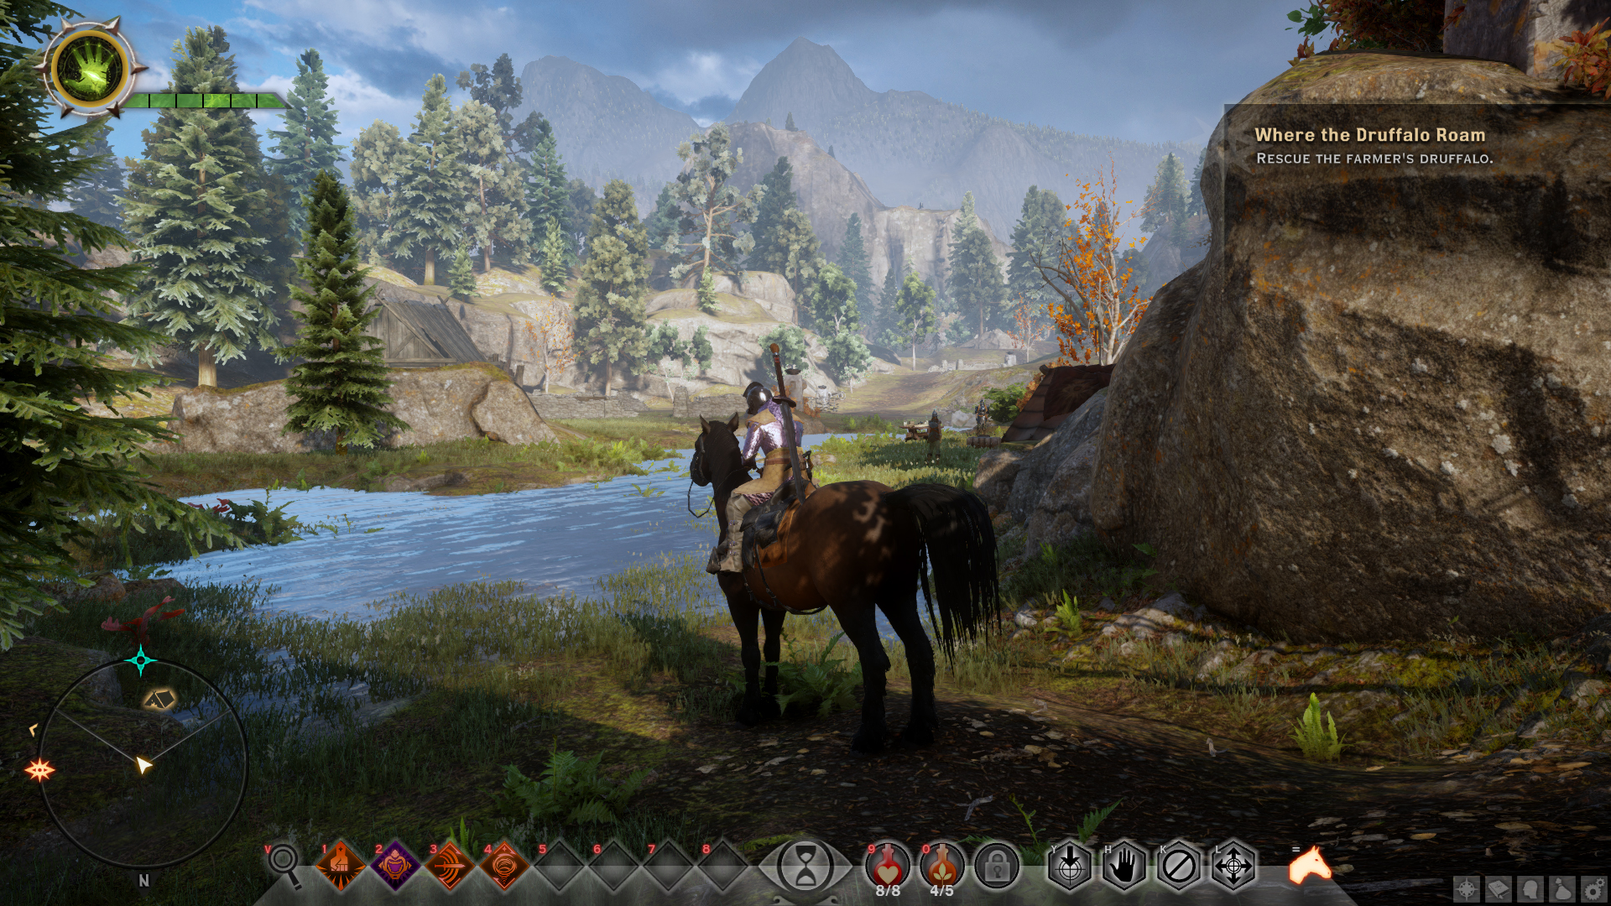
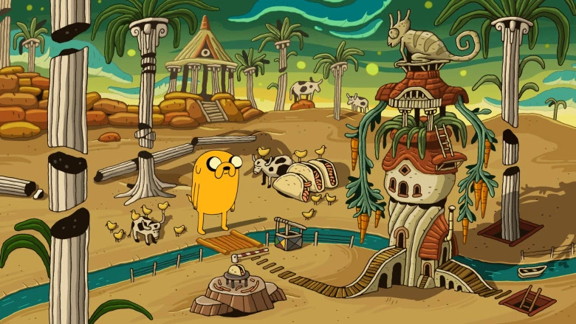
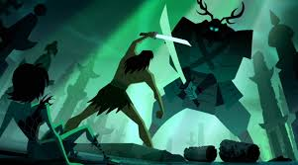

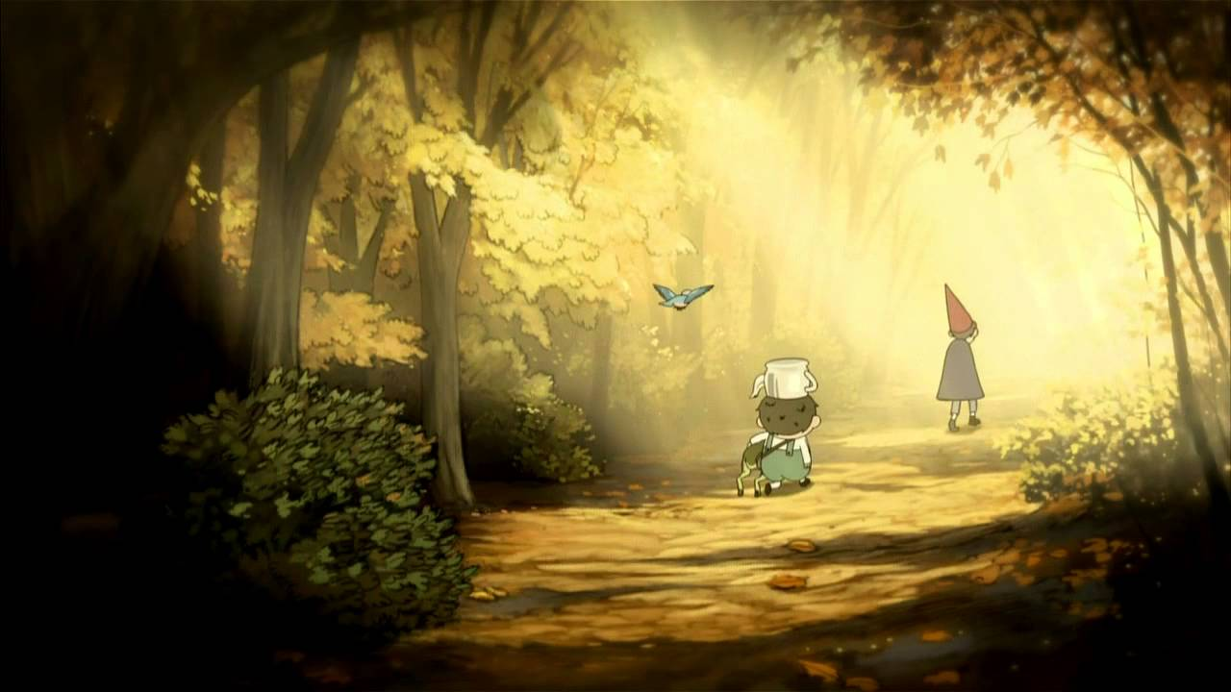
Inspired by the Shonen and Adventure Genres

Slide 6
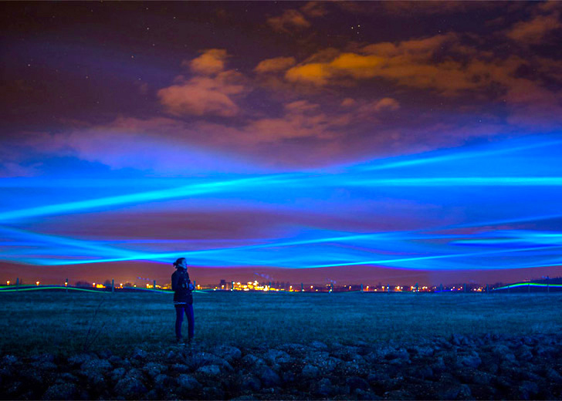
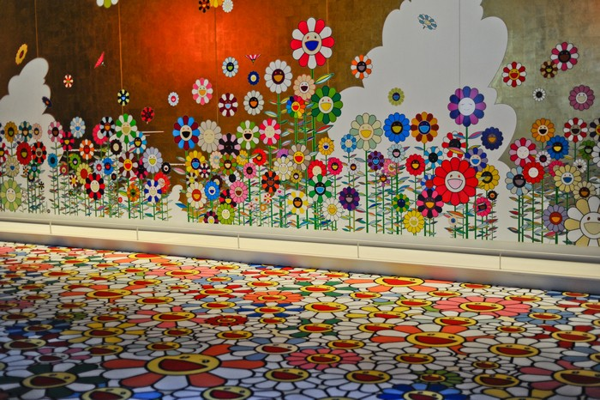
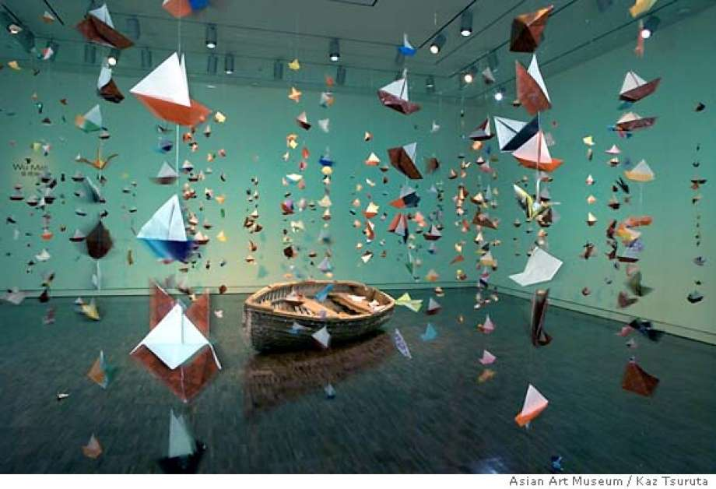
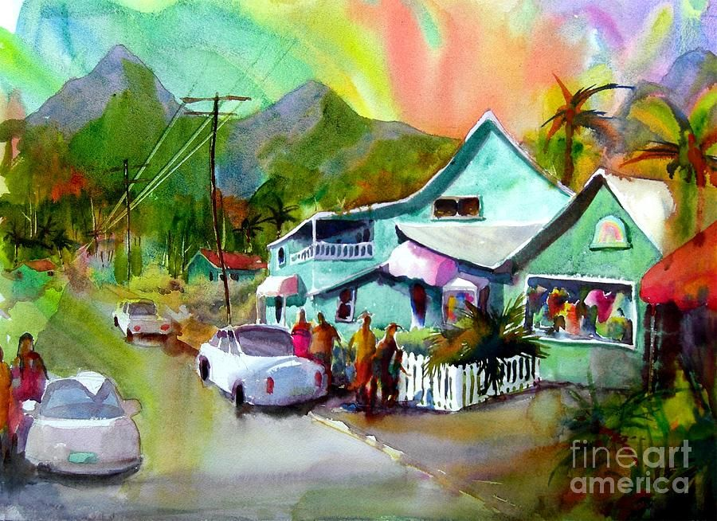
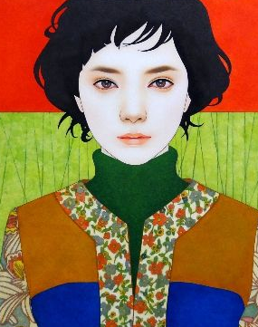
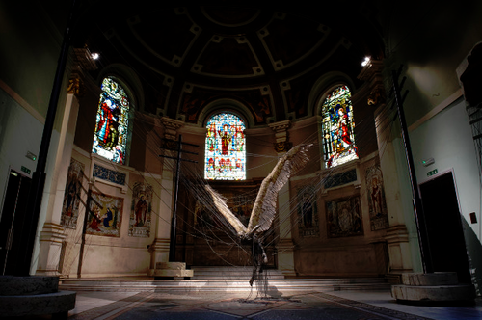
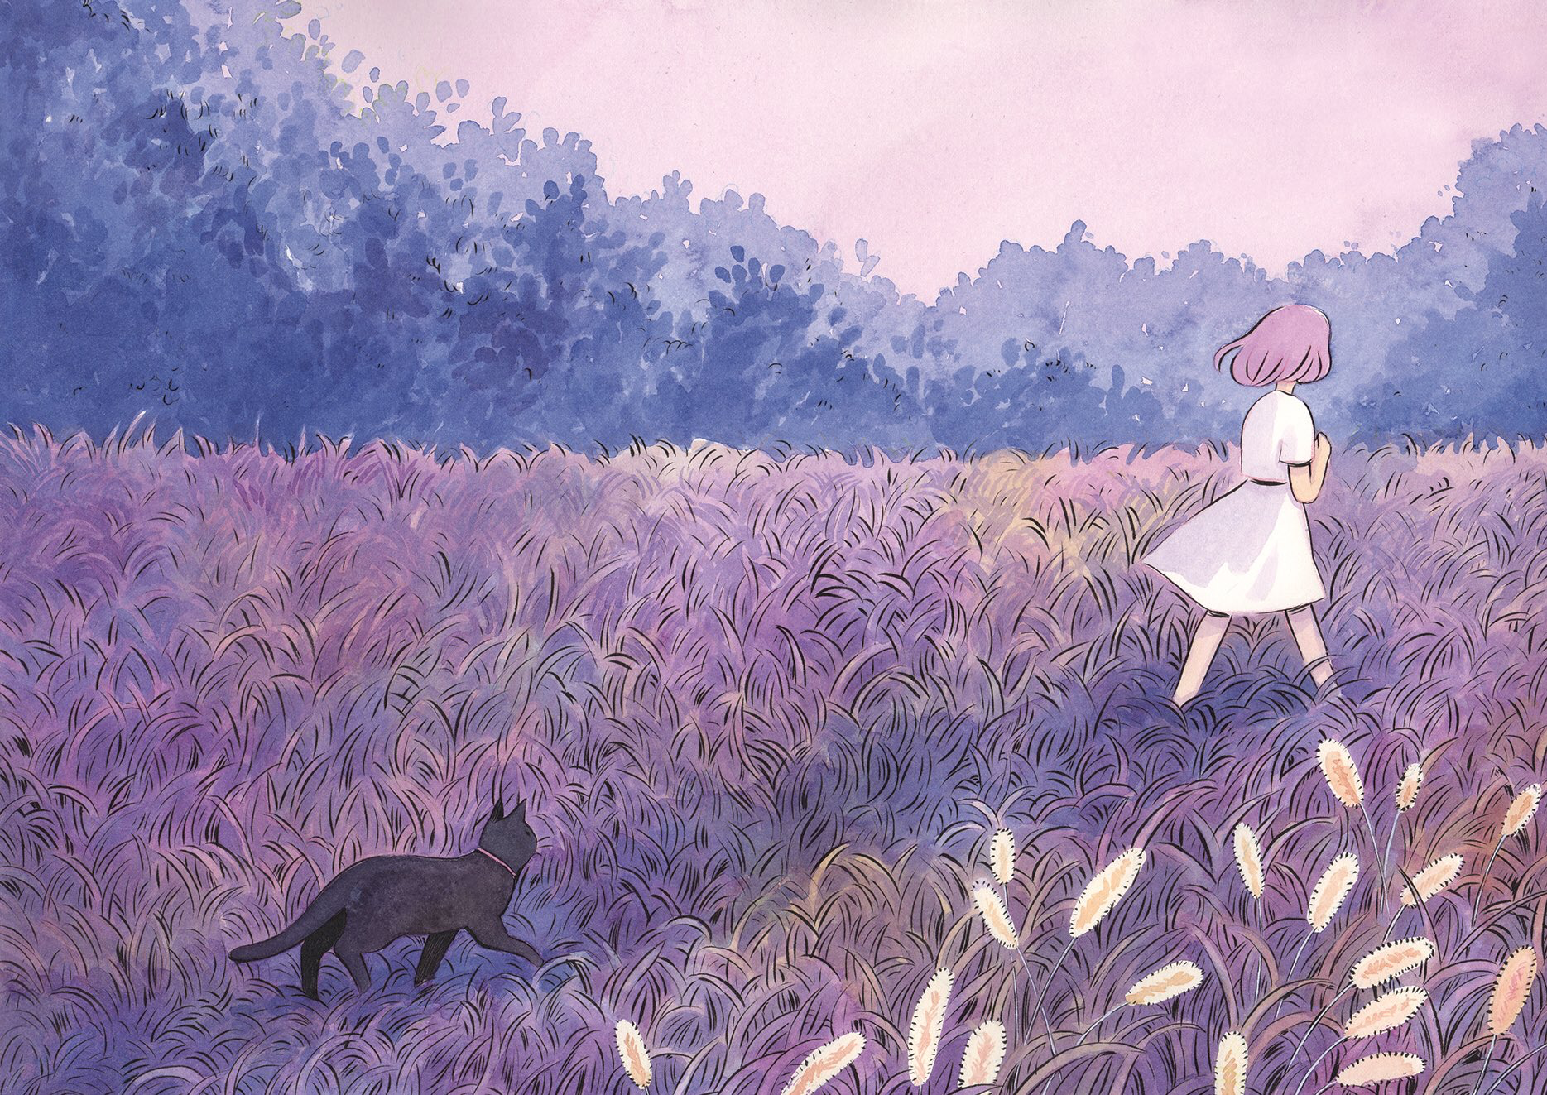
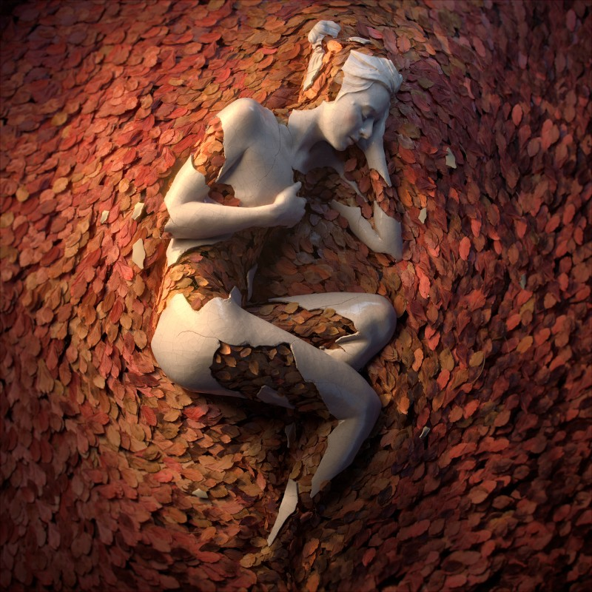
“Canvases”- The Students’ Art Worlds

Slide 7
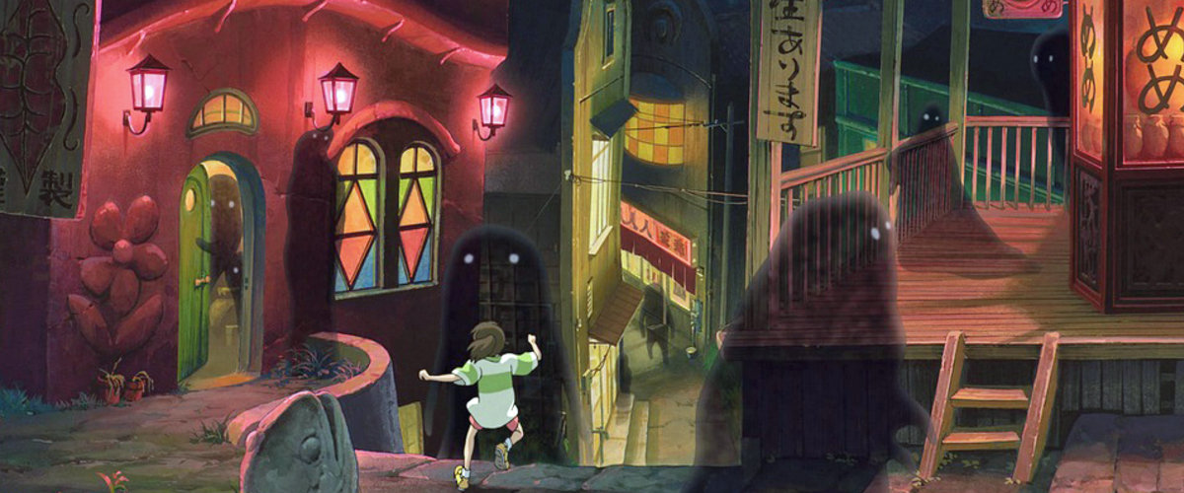

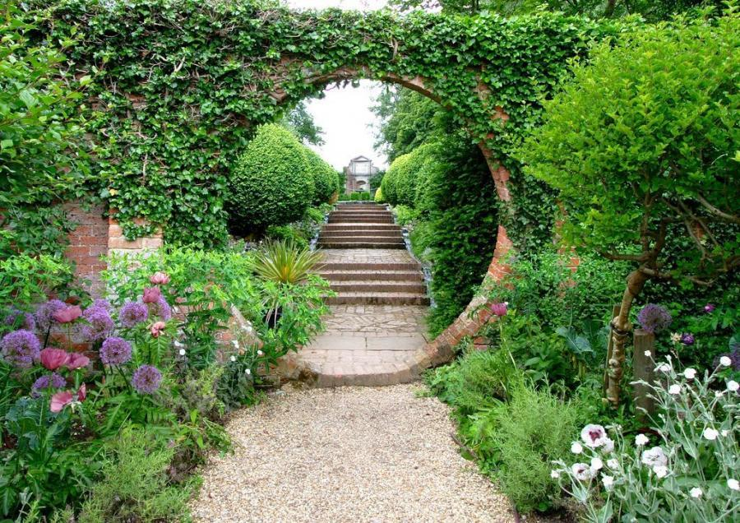
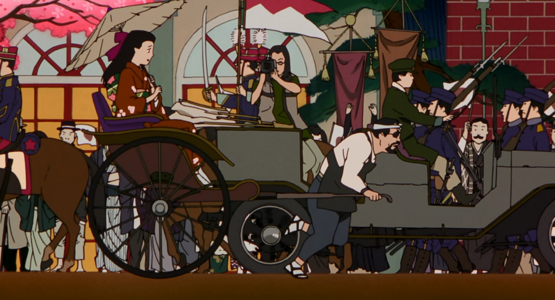
Entering another person’s Canvas = entering the Magic Circle

Slide 8
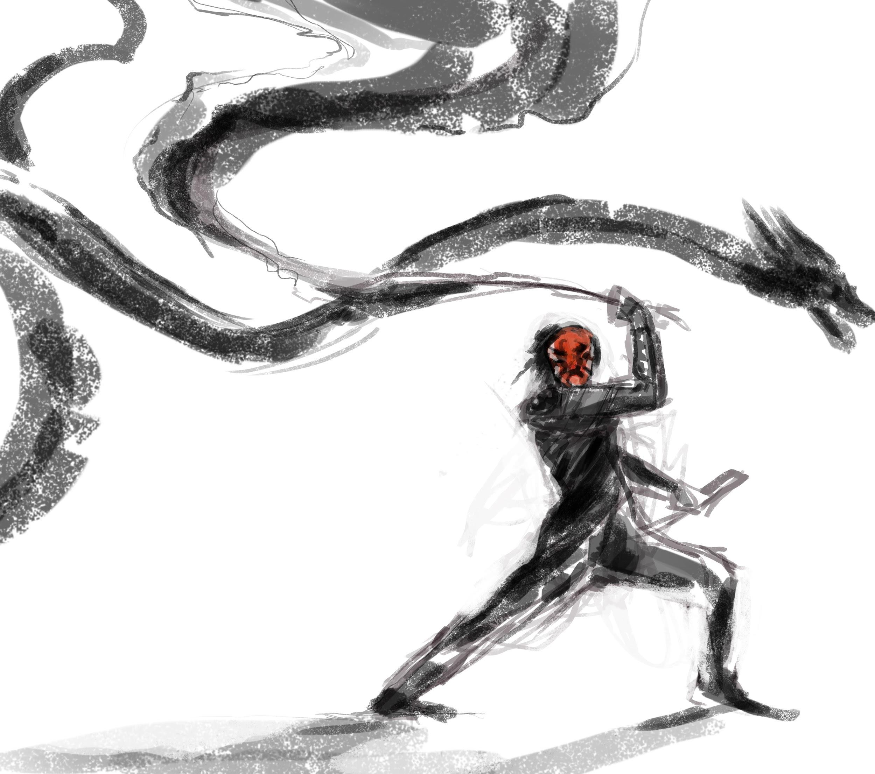
The Art Vandal
Dragons have been appearing in the Canvases of the students and wrecking them apart.
Emily is the new girl, and she could bring dragons to life.
People think that she is the one who has done it.

Slide 9
Importance of:
Asian American Women in Cinema
Arts Education -> Mental Health
Listening -> Collaboration

Slide 10
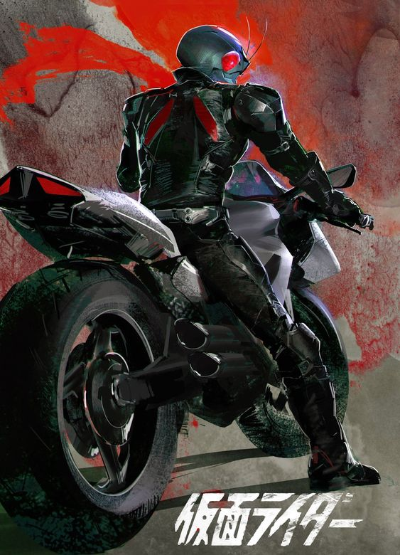

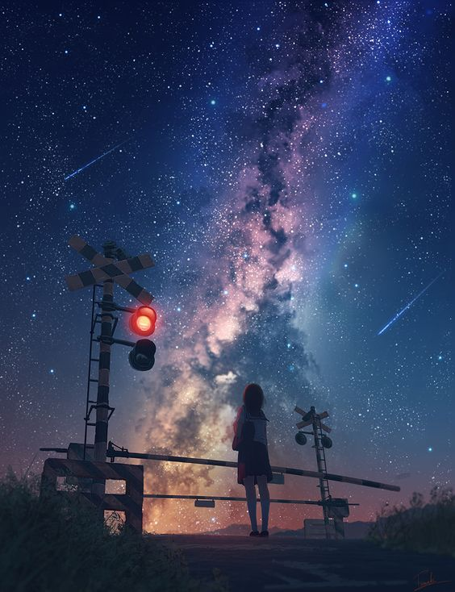

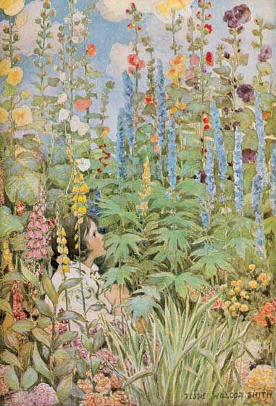
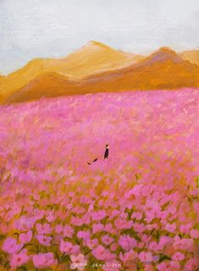
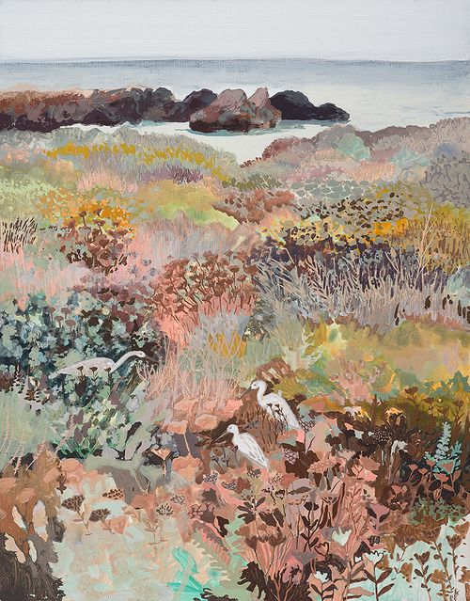
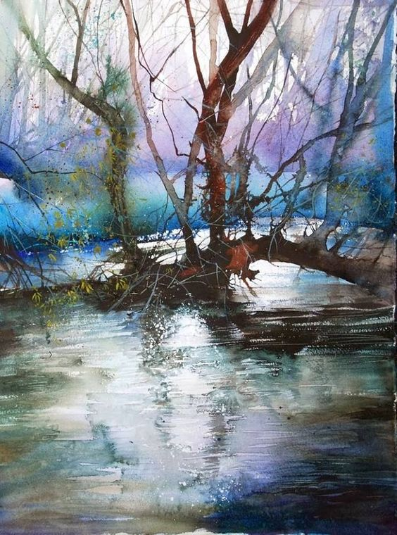
Emily Xue (15)
Sina Xue (14)
Characters
Goofy. Loves making silly things.
Dramatic, sensitive, intense.
Always gets in trouble (internal).
Emily’s younger sister.
Lazy, chill, don’t care.
Lustful, loves food.
Always gets in trouble (external).

Slide 11
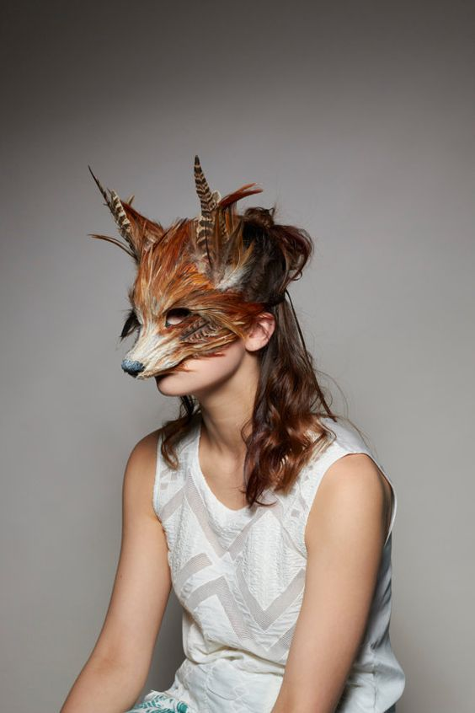
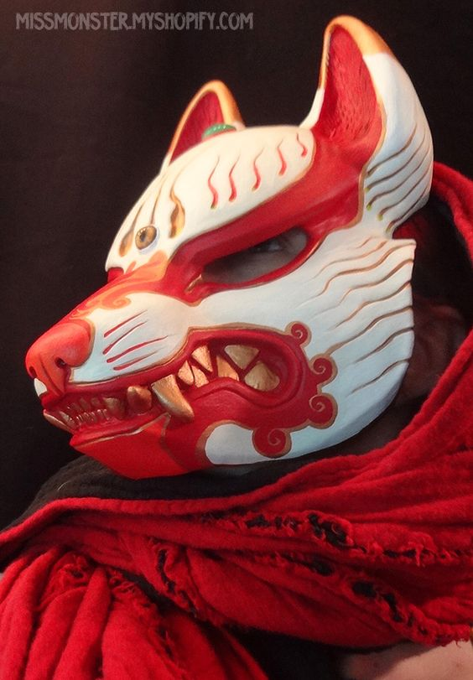
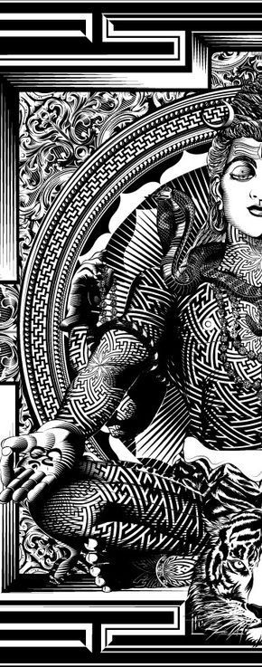
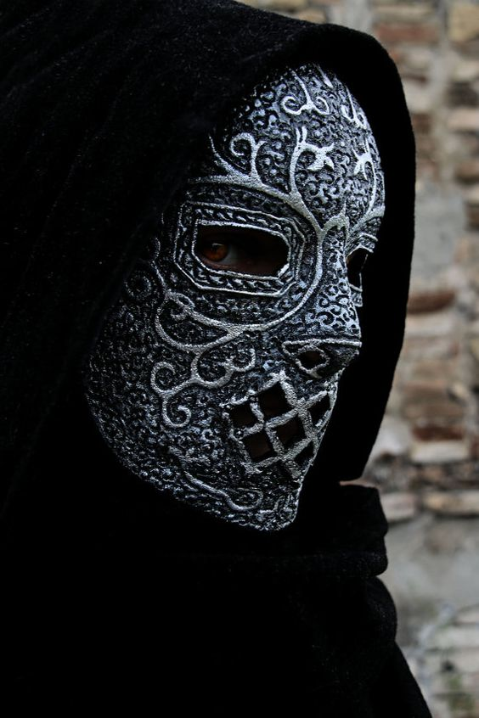
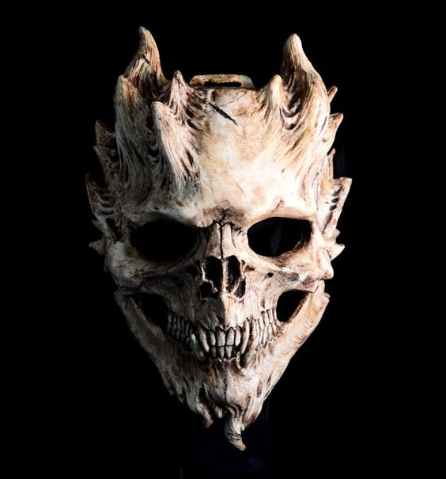
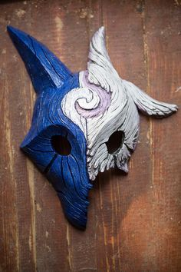
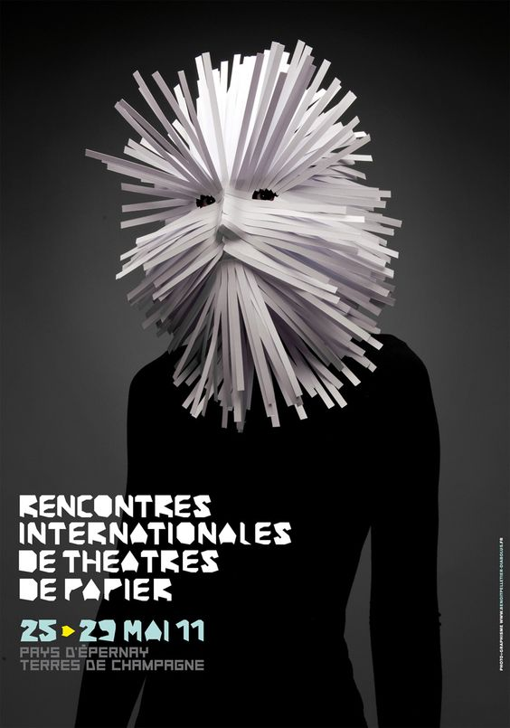
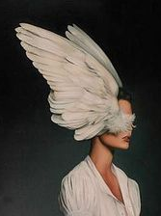
Mask Aesthetic
All people wear masks in their Canvases.

Slide 12
The Impending Doom:
Death of the Arts Program

Slide 13
Students identify each other through art that they make. As funding for arts programs are cut for arming teachers instead, students realize that they have to collaborate with each other - vastly different personalities - towards a common goal of saving the arts program.

Slide 14
The academic competition at the school creates anxiety and depression. At the end of the day, students learn to focus on themselves through the arts. The students realize that without the arts program, the incoming freshmen are struggling even more with identity, passion, and mental health.

Slide 15
Each episode:
Meeting another student
(new acquaintance? Or drama?)
Emily tries to improve her art skills
(self reflection + practice, longer takes)
Emily finds more clues about the art vandal

Slide 16
Animated Characters
Live Action Backgrounds
Traveling into another world

Slide 17
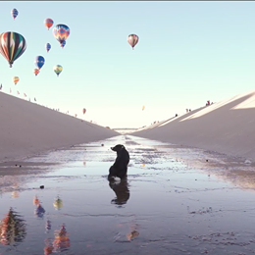
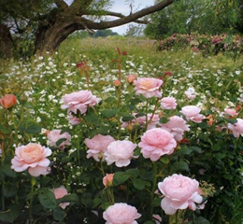
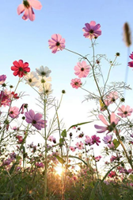
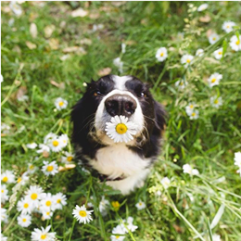

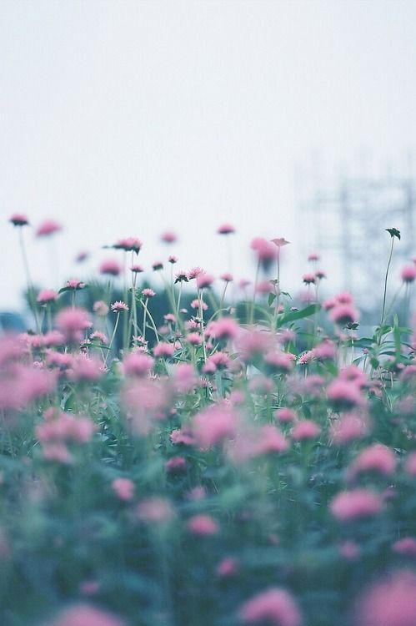

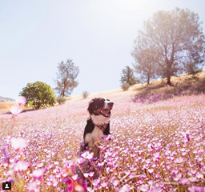
Inspired by

Slide 18
